Slide 1
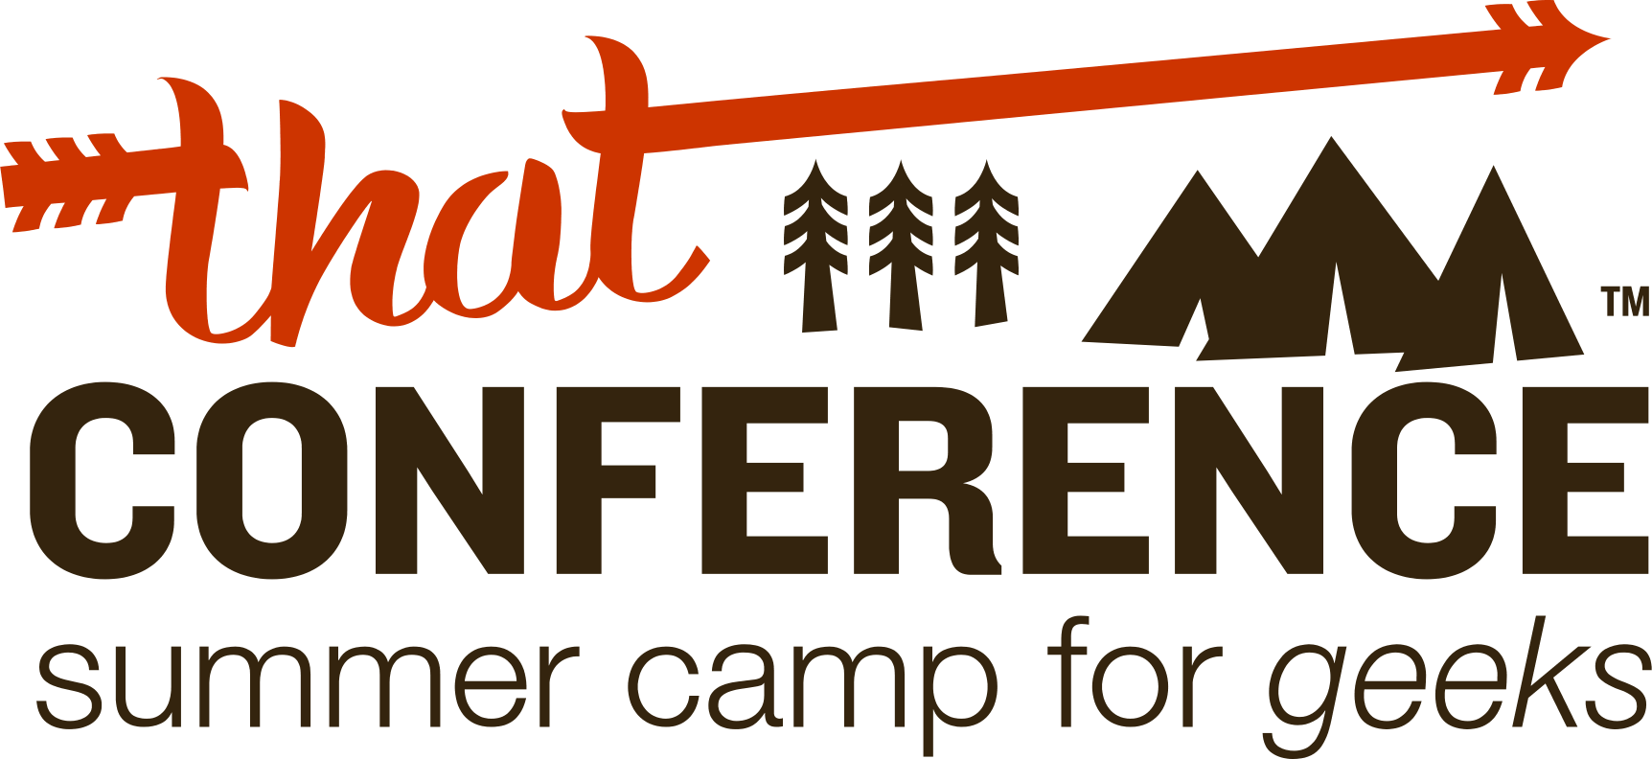

Slide 2

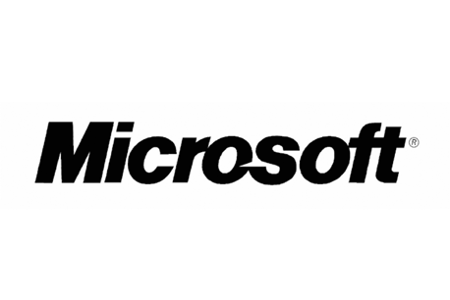


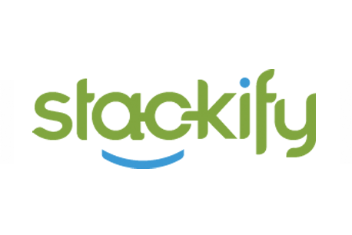
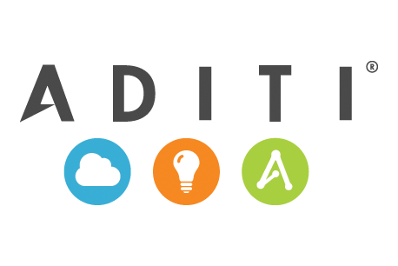
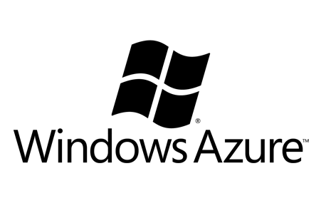
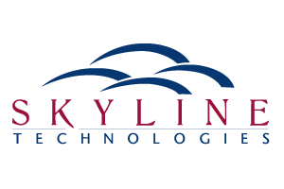
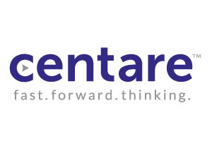
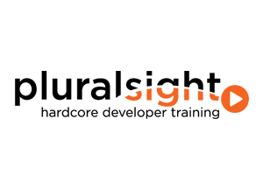

Slide 3
Simplifying Domain Driven Design
Using an event driven architecture and CQRS

Slide 4
Simplifying Domain Driven Design
Using an event driven architecture and CQRS
Impact of using your domain model for reading
CQRS pattern and how it can help you
Event Sourcing

Slide 5
Ever ask yourself…
What is the best way to populate my screen using my domain model?
I need to show aggregated data such as totals on my screen. How do I implement this using my domain model?
I’m having problems writing complicated queries with my ORM. What are my options?
Notes:
Q1) Your domain model typically doesn’t match the screen’s needs.
You’ll see later in the presentation that a domain model only contains state that it needs for business decisions or changes
I know everybody is used to seeing all properties available and “drillable” through he object graph but when DDD is done correctly the model doesn’t look this way.
Q2) Tuning queries with an ORM can be complicated and cumbersome
I’ve written several applications using NHibernate as my persistence mechanism. Writing LINQ or projections against my domain model from my repositories seems like a code smell.
Q3) Reads are meant to be fast. Joins to multiple tables can affect performance.
More than likely you’re using multiple repositories against multiple entities
Query your read store directly

Slide 6

Domain Object
Remote Facade
Application Services
Domain Object
Request DTO
Send DTO
Client
Notes:
Read Side
Client makes request, domain model is hydrated from database, DTO is populated from domain model and returned to client
Write Side
Client makes change to screen, DTO is sent up, domain model processes changes and data is persisted
How many of you are using an architecture similar to this?
What if I were to tell you that there is no way you could possibly be practicing DDD?
Notice that the same DTO sent down to the client is the same one that is being sent up
Task Based UI’s are as much a part of DDD as the domain model.
Capture the user’s intent

Slide 7
Projections
Projections
DTO
DTO
Domain Model
Domain Model
ORM
ORM
View Model
Projections
Projections
Projections
Projections
Projections
Projections
Client
Notes:
What’s the point in taking data from a relational database, projecting it to a domain model, only to the project it to a DTO, and finally to a view model. Why not shape our read data after our view models?

Slide 8
public class Incident
{
/// <summary>
/// Incident Id
/// </summary>
public virtual Guid Id { get; set; }
/// <summary>
/// Location where the incident occurred
/// </summary>
public virtual Location LocationOfIncident { get; set; }
/// <summary>
/// Employee that was injured
/// </summary>
public virtual Employee Employee { get; set; }
/// <summary>
/// Date the injury occurred
/// </summary>
public virtual DateTime DateOfInjury { get; set; }
/// <summary>
/// Date the incident was closed
/// </summary>
private virtual DateTime DateClosed { get; set; }
/// <summary>
/// Status of the incident.
/// 0 = pending, 1 = open, 2 = closed
/// </summary>
public virtual int Status { get; set; }
}
Notes:
Typical model used when reading and writing go through the domain
Properties are exposed publicly
Properties are 1st class citizens
No behavior
No way of enforcing consistency because some properties are entities of another aggregate.
The class is basically a property bucket

Slide 9
Impact of reading from your domain model
Properties that should be value objects end up as references to other entities
Property getters are exposed publicly
If property setters are publicly exposed, how can the aggregate root ensure consistency?
Performance
public class Incident
{
/// <summary>
/// Incident Id
/// </summary>
public virtual Guid Id { get; set; }
/// <summary>
/// Location where the incident occurred
/// </summary>
public virtual Location LocationOfIncident { get; set; }
/// <summary>
/// Employee that was injured
/// </summary>
public virtual Employee Employee { get; set; }

Slide 10
Ensuring Consistency
public void CloseIncident(Guid incidentId)
{
IncidentRepository repository = new IncidentRepository();
Incident incident = repository.GetIncident(incidentId);
if(incident.Status == 1) // if opened
{
incident.Status = 2; // set to closed
incident.DateClosed = DateTime.Now;
}
repository.Save();
}
public void CloseIncident(Guid incidentId)
{
IncidentRepository repository = new IncidentRepository();
Incident incident = repository.GetIncident(incidentId);
incident.Close();
repository.Save();
}
Notes:
The first example doesn’t show any behavior. It also doesn’t maintain consistency because you can change information at will

Slide 11
CQRS
Command Query Responsibility Segregation (CQRS) is simply the creation of two objects where there was previously only one. The separation occurs based upon whether the methods are a command or a query.

Slide 12
What is a command?
A message that contains the information to perform a state change
Names of commands are very explicit
public class CloseIncident
{
public Guid IncidentId { get; set; }
}

Slide 13
How do I implement CQRS?
Different objects for reading and writing
Different mechanism for reading data
  ADO to stored procedures
  Map directly to DTO from existing open source tools
Different data stores
  Separate store for reads and writes. Not required though.

Slide 14
Remote Facade
Thin Read Layer
Receive DTO
Request DTO
Client
Notes:
Back to what we’ve always done
Thin read layer straight to DTO

Slide 15
Command
Query
Domain Object
Remote Facade
Application Services
Domain Object
Remote Facade
Thin Read Layer
Send Command
Request DTO
Client
Notes:
Simplest version of CQRS
You’ll notice that the message sent back up isn’t the DTO that came down. It is a command.

Slide 16
public class Incident
{
private Guid Id { get; set; }
private Guid LocationId { get; set; }
private Guid EmployeeId { get; set; }
private DateTime DateOfInjury { get; set; }
private int Status { get; set; }
private DateTime DateClosed { get; set; }
private DateTime DateOpened { get; set; }
public void Close()
{
if(Status == 1) // if opened
{
Status = 2; // set to closed
DateClosed = DateTime.Now;
}
}
public void Open()
{
if(Status == 0) // if pending
{
Status = 1; // set to open
DateOpened = DateTime.Now;
}
}
}
Notes:
Now let’s look at the same domain model when we stop using it for reading
Properties are private
Behavior exists
State only exists that is needed for making decisions or changes

Slide 17
Where is the read storage?
Same transactional model you write to
Separate store that can be denormalized for performance
Notes:
Where is the read storage?
Same transactional model you write to.
Don’t benefit from a scalability level
Typically used with an ORM
Completely separate store where data is denormalized

Slide 18

Denormalize your data!
Reduces joins and improves performance
Notes:
For years we’ve been taught to normalize our data structures. This makes sense for transactional data, but for reading data this is inefficient.

Slide 19
Handlers
Events
Domain Object
Remote Facade
Application Services
ORM
Domain Object
Remote Facade
Thin Read Layer
Send Command
Request DTO
Client
Notes:
Let’s take a look at how our architecture changes when we separate our read/write stores.
You’ll notice from this diagram that we still have a relational transactional model and a denormalized read model
1.) Command is processed
2.) Domain model persists to it’s relational storage
3.) Domain model raises an event asynchronously to update the read storage.
Pros
Read model is more scalable
Never underestimate the experience of your team working with technologies that they are comfortable with
Cons
Maintaining 2 different relational models can be complicated and cumbersome to maintain.

Slide 20
What is an event?
A message that represents an interesting occurrence in the domain
Names of events are very explicit
Verbs in the past tense
public class IncidentClosed
{
public Guid IncidentId { get; set; }
}

Slide 21
public class Incident
{
private Guid Id { get; set; }
private Guid LocationId { get; set; }
private Guid EmployeeId { get; set; }
private DateTime DateOfInjury { get; set; }
private int Status { get; set; }
private DateTime DateClosed { get; set; }
private DateTime DateOpened { get; set; }
public void Close()
{
if(Status == 1) // if opened
{
Status = 2; // set to closed
DateClosed = DateTime.Now;
// Raise an event that the incident was closed
DomainEvents.Raise(new IncidentClosed {IncidentId = this.Id , DateClosed = this.DateClosed});
}
}
public void Open()
{
if(Status == 0) // if pending
{
Status = 1; // set to open
DateOpened = DateTime.Now;
// Raise an event that the incident was opened
DomainEvents.Raise(new IncidentOpened {IncidentId = this.Id , DateOpened = this.DateOpened});
}
}
}
Notes:
How is the read model updated?
The domain events pattern

Slide 22
Events
Handlers
Events
Remote Facade
Thin Read Layer
Domain Object
Remote Facade
Application Services
Domain Object
Send Command
Request DTO
Client
Notes:
Why bother with a relational model for the write side at all?
Remove the ORM completely
Event Sourcing
Benefits
Get a true history of state changes
Free auditing
Easy to handle concurrency issues because every event has a version

Slide 23
How are events stored?
Relational database
NoSQL database
Column Type Description
EventId long auto increment
AggregateId Guid Id of aggregate
EventType string full class name
EventData string json value of event
EventDate DateTime date of the event

Slide 24
How do I project events to my read model?
Create event listeners
Publish events
  Some form of a message bus
  Could use something as simple as an IoC container to register all of your event listeners then invoke each when appropriate.
void IHandles<IncidentClosed>.Handle(IncidentClosed @event)
{
// e.g., execute stored procedure to update
}

Slide 25
How are aggregates hydrated?
Events
Deserialize Event
Apply Event
Get Next Event
void IHandles<CloseIncident>.Handle(CloseIncident command)
{
IRepository<Incident> repository = new Repository<Incident>();
Incident incident = repository.GetById(command.IncidentId);
// call behavior etc…
}

Slide 26
public class Incident : AggregateRoot
{
private int _status; // incident status
public void Close()
{
if(_status == 1) // if open
ApplyChange(new IncidentClosed {Id = Id, DateClosed = DateTime.Now});
}
public void Open()
{
if(_status == 0) // if pending
ApplyChange(new IncidentOpened {Id = Id, DateOpened = DateTime.Now});
}
private void Apply(IncidentOpened e)
{
_status = 1; // set to open
}
private void Apply(IncidentClosed e)
{
_status = 2; // set to closed
}
}
Notes:
You’ll notice that the only state that is maintained in the model is state that is needed to make a decision for other behaviors
You’ll notice that “in general” you’ll have an Apply() method for every behavior. You won’t have one in situations where the model simply doesn’t care about storing that state in a variable
Advantages of event sourcing
Free auditing
Have the ability to build multiple read models with the same information
Have the ability to rebuild your read model at any point by replaying the events
You’ll also notice that the term “DDD is about behavior, not shape” actually has meaning when using event sourcing.
Disadvantages
Can be hard to sell to an organization
Difficult to migrate a legacy app to

Slide 27
Observations
Won’t it be slow hydrating your aggregate roots?
What do you do when your event store has performance issues?
Notes:
Won’t it be slow hydrating your objects by replaying the events?
What the odds of an aggregate having more than a few events?
What do you do when your event store has performance issues?
Snapshots

Slide 28
Business Objects
Site A
Business Objects
Site B
Data Access Layer
Data Access Layer
Site D
Domain Model
DTO
Site C
NHibernate
Data Access
Notes:
Example of 3 sites that are all doing the same tasks, yet were developed separately with different databases as well as architectures. How can we share a domain model and services between the 3 sites yet let all the queries already written stay the same?
The next slide shows how this can be accomplished.

Slide 29
Update Read Storage
Domain Model
Command Handlers
Web Service
Data Access Layer
Business Objects
Data Access Layer
Business Objects
Data Access Layer
DTO
Site A
Site B
Site C
Commands
Notes:
Although it is complicated to take an existing RDBMS and build events from it that is effectively what would need to be done.
Populate event store with data from the 3 RDBMSs
Change all persistence related commands from each system to call the new services
Write handlers to update the appropriate read models.
As mentioned earlier, this is no easy task but combining 3 systems to work together isn’t exactly an easy task no matter what the solution is. By using CQRS along with ES this allows you to have a consistent domain model across applications that need the same domain model. One major reason for this solution above was to allow customers to move from product to product for upgrade purposes as well as allowing customers to “share” data across systems. Although all three products were similar, there were features that were considered upsells. This allowed us to easily upgrade a customer from one system to another fairly simply.

Slide 30
Why use CQRS
Performance and Scalability
Allows you to model your domain without polluting it with read concerns
Incredibly flexible to fit your needs
Developers can work independently across models

Slide 31
Resources
CQRS Website
  http://cqrs.wordpress.com/
DDD/CQRS Group
  http://groups.google.com/group/dddcqrs
DDD Group
  http://tech.groups.yahoo.com/group/domaindrivendesign/
CQRS Founders
  Greg Young
  Udi Dahan http://www.udidahan.com/
Domain Events
  http://codebetter.com/gregyoung/2010/04/11/what-is-a-domain-event/
  http://www.udidahan.com/2009/06/14/domain-events-salvation/
Event Sourcing
  http://martinfowler.com/eaaDev/EventSourcing.html

Slide 32
Next Year….
August 12th – 14th 2013

